Slide 1
WEB DEVELOPMENT COURSE
FRONT-END
SESSION 2
JUL, 2023

Slide 2
What is HTML5?
HTML5 is the latest version of Hypertext Markup Language, the code that describes web pages. It's actually three kinds of code: HTML, which provides the structure; Cascading Style Sheets (CSS), which take care of presentation; and JavaScript, which makes things happen.

Slide 3
What's so great about HTML5?
HTML5 has been designed to deliver almost everything you'd want to do online without requiring additional software such as browser plugins. It does everything from animation to apps, music to movies, and can also be used to build incredibly complicated applications that run in your browser.

Slide 4
What does HTML5 do?
We've come a long way since HTML could barely handle a simple page layout. HTML5 can be used to write web applications that still work when you're not connected to the net; to tell websites where you are physically located; to handle high definition video; and to deliver extraordinary graphics.

Slide 5
What’s new about HTML5
HTML5 new tags : <main>, <section>, <article>, <header>, <footer>, <aside>, <nav> and <figure>, are added. New attributes are introduced, some elements and attributes
have been removed, and others such as <a>, <cite> and <menu> have been changed, redefined or standardized. At the very top of the page you will see the doctype declaration: <!DOCTYPE html>

Slide 6
HTML5 vs HTML
HTML vs HTML5 – Comparison
Both HTML and HTML5 are hypertext markup languages, primarily used to develop web pages or applications. HTML5 is the latest version of HTML and supports new markup language functionalities such as multimedia, new tags and elements as well as new APIs. HTML5 also supports audio and video.

Slide 7
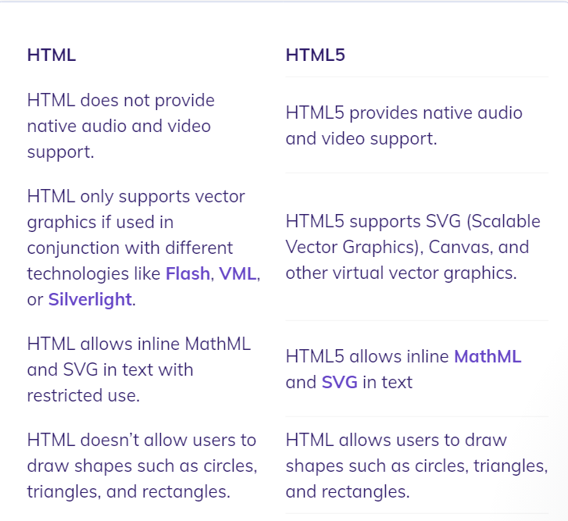

Slide 8
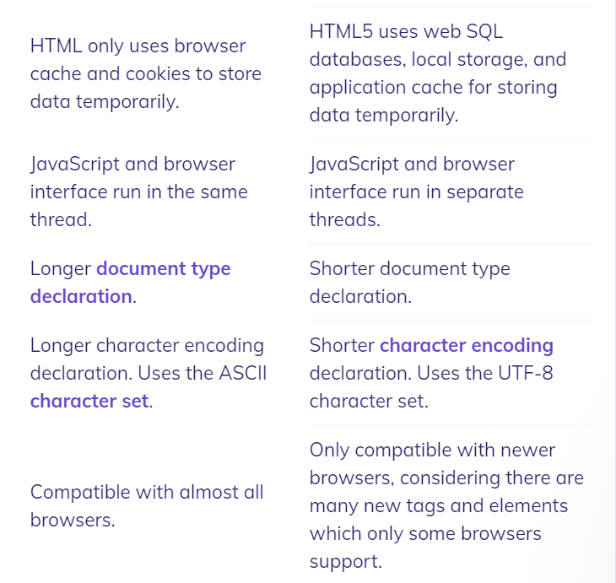

Slide 9
But what is the real major difference?
It’s a simple answer: layouts
So, as we know HTML5 introduced some new concepts which made a major difference in the structure and the layout of it.

Slide 10
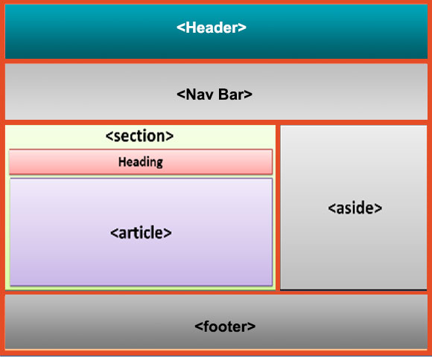

Slide 11
HTML5 layout explained
header: Used to include header content in the web page, like information about the page, summary, login/register links. shopping cart details etc.
nav: Used to provide navigational links, ex: menus for routing through across the application pages.
section: Used to represent a section in the web page and it can be anything such as quick news section, headline, etc.

Slide 12
HTML5 layout explained
article: As the name suggests, it’s a separate section used to include a blog, a forum post, a magazine article, etc.
aside: As the name suggests, it's used to include some extra information regarding the main content.
footer: Used to include footer content in the web page, like licensing information, copyright information, some quick access links, etc.

Slide 13
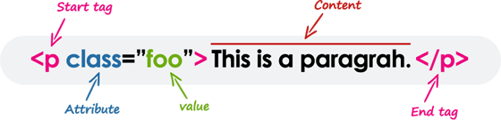
Now, let’s get back to the elements and tags conflict
HTML Tags Vs Elements
Technically, an HTML element is the collection of start tag, its attributes, an end tag and everything in between. On the other hand an HTML tag (either opening or closing) is used to mark the start or end of an element, as you can see in the above illustration.

Slide 14
Course objective No.2:
Let’s write some code !!

Slide 15
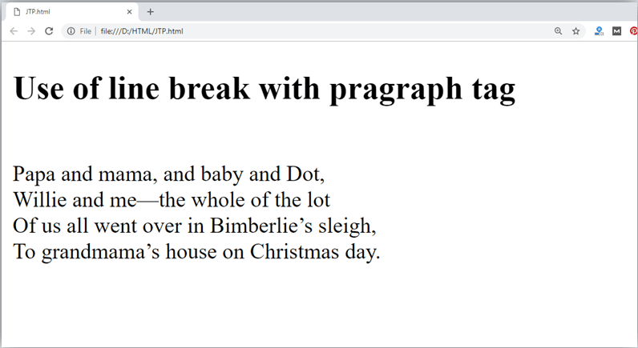
Your second HTML element:
The paragraph tag

Slide 16
Hands-on 1:
Introduce yourself in a p tag
Hint: mix it up with some H tags

Slide 17
Block-level Elements
A block-level element always starts on a new line, and the browsers automatically add some space (a margin) before and after the element.
A block-level element always takes up the full width available (stretches out to the left and right as far as it can).
Two commonly used block elements are: <p> and <div>.
Notes:
The <p> element defines a paragraph in an HTML document.
The <div> element defines a division or a section in an HTML document.

Slide 18
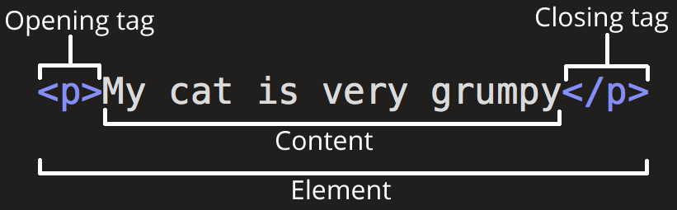
Reminder: What is tags?:

Slide 19
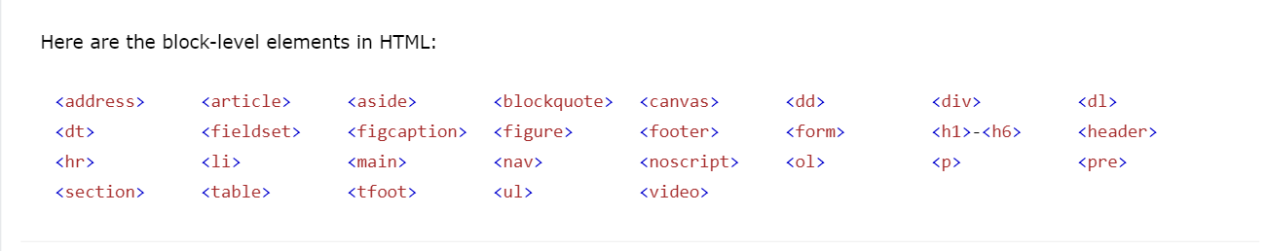
Block-level elements examples

Slide 20
Hands-on 2:
Let’s give it a try
<h1>-<h6>, <header>, <address>, <article>, <aside>, <main>,

Slide 21
Inline Elements
An inline element does not start on a new line.
An inline element only takes up as much width as necessary.
This is a <span> element inside a paragraph.

Slide 22
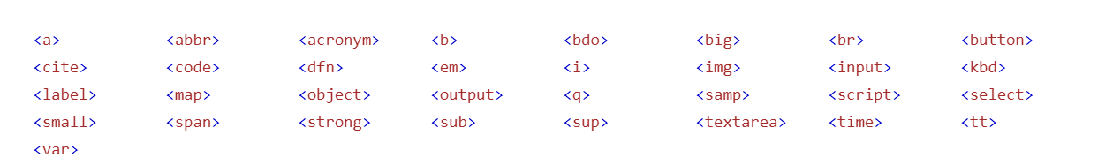

Slide 23
Hands-on 3:
Let’s give it a try
<bdo>,<br>,<b>,<a>,<I>,<img>,<q>, <small>,<span>,<strong>

Slide 24
Inline Elements
<bdo>: Specify the text direction
<br>: line breaks
<b>: Make some text bold (without marking it as important.
<a>: Create a link
<I>: Italic text

Slide 25
Inline Elements
<q>: Mark up a short quotation
<small>: Define a smaller text
<span>: is an inline container used to mark up a part of a text.
<strong>: element defines text with strong importance

Slide 26
The <img> tag:
The <img> tag is used to embed an image in an HTML page.
Images are not technically inserted into a web page; images are linked to web pages. The <img> tag creates a holding space for the referenced image.
The <img> tag has two required attributes:
src - Specifies the path to the image
alt - Specifies an alternate text for the image, if the image for some reason cannot be displayed

Slide 27
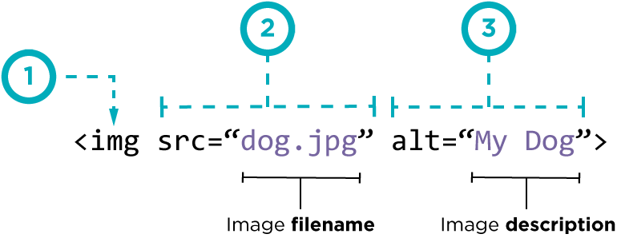

Slide 28
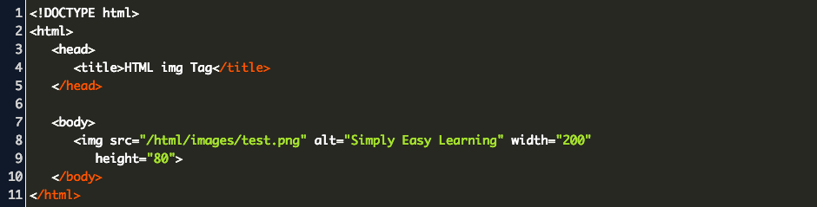

Slide 29
Anchors and Hyperlinks

Slide 30
The <a> tag:
The <a> tag defines a hyperlink, which is used to link from one page to another.
The most important attribute of the <a> element is the href attribute, which indicates the link's destination.
By default, links will appear as follows in all browsers:
An unvisited link is underlined and blue
A visited link is underlined and purple
An active link is underlined and red

Slide 31
Hands-on 4:
How to open a link in a new browser window:
How to link to another section on the same page
How to use an image as a link (challenge)

Slide 32
HTML Attributes
HTML attributes provide additional information about HTML elements.
All HTML elements can have attributes
Attributes provide additional information about elements
Attributes are always specified in the start tag
Attributes usually come in name/value pairs like: name="value"

Slide 33
HTML Attributes
The href Attribute
The <a> tag defines a hyperlink. The href attribute specifies the URL of the page the link goes to:
Example
<a href="https://www.google.com">Visit google</a>

Slide 34
HTML Attributes
The src Attribute
The <img> tag is used to embed an image in an HTML page. The src attribute specifies the path to the image to be displayed:
Example
<img src="img_girl.jpg">

Slide 35
HTML Attributes
The width and height Attributes
The <img> tag should also contain the width and height attributes, which specifies the width and height of the image (in pixels):
Example
<img src="img_girl.jpg" width="500" height="600">

Slide 36
HTML Attributes
The alt Attribute
The required alt attribute for the <img> tag specifies an alternate text for an image, if the image for some reason cannot be displayed. This can be due to slow connection, or an error in the src attribute, or if the user uses a screen reader.
Example
<img src="img_girl.jpg" alt="Girl with a jacket">

Slide 37
HTML Attributes
The style Attribute
The style attribute is used to add styles to an element, such as color, font, size, and more.
Example
<p style="color:red;">This is a red paragraph.</p>

Slide 38
HTML Attributes
The title Attribute
The title attribute defines some extra information about an element.
The value of the title attribute will be displayed as a tooltip when you mouse over the element:
Example
<p title="I'm a tooltip">This is a paragraph.</p>

Slide 39
Recap time !!

Slide 40
Q&As time !!

Slide 41
Thank you folks
Have a good day

